Slide 1
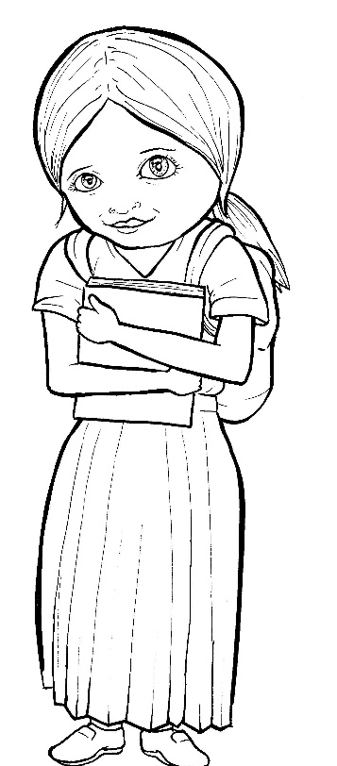

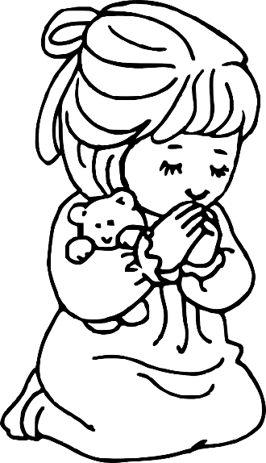
Part 5
49. Growing as a Christian
Vocabulary
Original Bible Story

Slide 2
Vocabulary

Slide 3
establish
(es - TAB - lish):
to begin something

Slide 4
abound
(a - BOUND):
to be filled with

Slide 5
dwell
(dwell):
to live in

Slide 6
admonish
(ad - MON - ish):
to remind

Slide 7
spiritual
(SPIR – it – u- al):
about God or heaven

Slide 8
steadfast
(STEAD- fast):
to firmly keep going

Slide 9
Growing as a Christian
Colossians 2:6-7; 16-17; 4:2a
World English Bible (WEB)

Slide 10
As therefore you received Christ Jesus, the Lord, walk in him, rooted and built up in him,

Slide 11
and established in the faith, even as you were taught, abounding in it in thanksgiving.

Slide 12
Let the word of Christ dwell in you richly; in all wisdom teaching and admonishing one another with psalms, hymns,

Slide 13
and spiritual songs, singing with grace in your heart to the Lord.

Slide 14
Whatever you do, in word or in deed, do all in the name of the Lord Jesus, giving thanks to God the Father, through him.

Slide 15
Continue steadfastly in prayer, watching in it with thanksgiving.

